Slide 1
IoT프로그래밍 8주차 과제
YA반 학번: 20202296 이름: 전채린

Slide 2
과제1 다음 표를 채우세요
저항값 | 최대 감지 거리
2 kΩ | 30cm
4.7 kΩ | 20cm
1 kΩ | 50cm
주파수 | 최대 감지 거리
38000 | 30cm
39000 | 25cm
40000 | 20cm
41000 | 15cm
42000 | 10cm

Slide 3
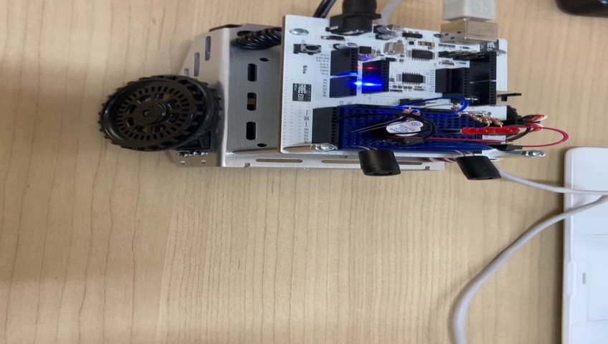
과제2 적외선센서 활용 속도 절반 동작 영상

Slide 4
과제2 적외선센서 활용 속도 절반 스케치
/* IRLED05 */
/* ABOT의 속도를 반으로 줄이도록 speedLeft와 speedRight를 수정 */
#include <Servo.h> // Include servo library
Servo servoLeft; // Declare left and right servos
Servo servoRight;
void setup() { // Built-in initialization block
pinMode(10, INPUT); pinMode(9, OUTPUT);//Left IR LED & Receiver
pinMode(3, INPUT); pinMode(2, OUTPUT);//Right IR LED & Receiver
pinMode(8, OUTPUT); pinMode(7, OUTPUT);// Indicator LEDs
tone(4, 3000, 1000); // Play tone for 1 second
delay(1000); // Delay to finish tone
servoLeft.attach(13); // Attach left signal to pin 13
servoRight.attach(12); // Attach right signal to pin 12
}
void loop() { // Main loop auto-repeats
int irLeft = irDetect(9, 10, 38000); // Check for object on left
int irRight = irDetect(2, 3, 38000);// Check for object on right
digitalWrite(8, !irLeft); // LED states opposite of IR
digitalWrite(7, !irRight);
if((irLeft == 0) && (irRight == 0)) // If both sides detect
{ maneuver(-50, -50, 20); } // Backward 20 milliseconds
else if(irLeft == 0) // If only left side detects
{ maneuver(50, -50, 20); } // Right for 20 ms
else if(irRight == 0) // If only right side detects
{ maneuver(-50, 50, 20); } // Left for 20 ms
else // Otherwise, no IR detects
{ maneuver(50, 50, 20); } // Forward 20 ms
}
int irDetect(int irLedPin, int irReceiverPin, long frequency)
{
tone(irLedPin, frequency, 8); // IRLED 38 kHz for at least 1 ms
delay(1); // Wait 1 ms
int ir = digitalRead(irReceiverPin); // IR receiver -> ir variable
delay(1); // Down time before recheck
return ir; // Return 1 no detect, 0 detect
}
void maneuver(int speedLeft, int speedRight, int msTime)
{ // speedLeft, speedRight ranges: Backward Linear
// Stop Linear Forward
// -100......0......100
// Set Left servo speed
servoLeft.writeMicroseconds(1500 + speedLeft);
// Set right servo speed
servoRight.writeMicroseconds(1500 - speedRight);
if(msTime==-1) // if msTime = -1
{
servoLeft.detach(); // Stop servo signals
servoRight.detach();
}
delay(msTime); // Delay for msTime
}

